Slide 1
Chapter 7: Routing Dynamically
IT2762 NETCOM
2018 S1

Slide 2
Chapter 7
7.1 Dynamic Routing Protocols
7.2 Distance Vector Dynamic Routing
7.3 RIP and RIPng Routing
7.4 Link-State Dynamic Routing
7.5 The Routing Table
7.6 Summary

Slide 3
Chapter 7: Objectives
Explain the basic operation of dynamic routing protocols.
Compare and contrast dynamic and static routing.
Categorize routing protocols.
Describe the process by which distance vector routing protocols learn about other networks.
Identify the types of distance-vector routing protocols.
Configure and verify the RIP routing protocol.
Configure and verify the RIPng routing protocol.
Determine the route source, administrative distance, and metric for a given route.

Slide 4
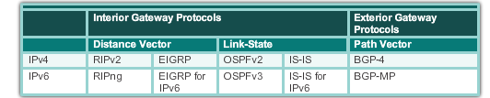
Dynamic Routing Protocol Operation
The Evolution of Dynamic Routing Protocols
Dynamic routing protocols have been used in networks since the late 1980s
  RIP (Routing Information Protocol) version 1 in 1988
  Updated to RIPv2 as networks become complex
  With increasing network complexity, newer protocols emerge
Newer versions support IPv6 networks
Notes:
7.1.1.1 The Evolution of Dynamic Routing Protocols

Slide 5
Dynamic Routing Protocol Operation
Purpose of Dynamic Routing Protocols
Routing protocols are used to facilitate the exchange of routing information between routers. Each routing protocol consists of a set of processes, algorithms and messages that are used to exchange routing information.
The purpose of dynamic routing protocols:
  Discover remote networks
  Maintain up-to-date routing information
  Choose the best path to destination networks
  Find a new best path if the current path is no longer available
Notes:
7.1.1.2 Purpose of Dynamic Routing Protocols

Slide 6
Dynamic Routing Protocol Operation
Purpose of Dynamic Routing Protocols (cont.)
Main components of dynamic routing protocols include:
Data structures - Routing protocols typically use tables or databases for its operations. This information is kept in RAM.
Routing protocol messages - Routing protocols use various types of messages to discover neighboring routers, exchange routing information, and to learn and update accurate information about the network.
Algorithm - Routing protocols use algorithms to determine best paths to destination networks.
Notes:
7.1.1.2 Purpose of Dynamic Routing Protocols (cont.)

Slide 7
Dynamic Routing Protocol Operation
The Role of Dynamic Routing Protocols
Advantages of using dynamic routing:
Routers will automatically share routing information
Dynamically determine the best path to known destination networks and add this information to its routing tables
Require less administrative overhead compared to static routing which must be maintained manually
Disadvantages of using dynamic routing:
Requires additional CPU, RAM and network bandwidth
Less secure compared to static routing
Can be more complex to implement
Certain network scenarios are more suitable for use with static routing
Networks typically use a combination of both static and dynamic routing.
Notes:
7.1.1.3 The Role of Dynamic Routing Protocols

Slide 8
Routing Protocol Operating Fundamentals
Dynamic Routing Protocol Operation
In general, the operations of a dynamic routing protocol can be described as follows:
The router sends and receives routing messages on its interfaces.
The router shares routing messages and routing information with other routers that are using the same routing protocol.
Routers exchange routing information to learn about remote networks.
When a router detects a topology change the routing protocol can advertise this change to other routers.
The next few slides show the operation of a dynamic routing protocol…
Notes:
7.1.3.1 Dynamic Routing Protocol Operation

Slide 9
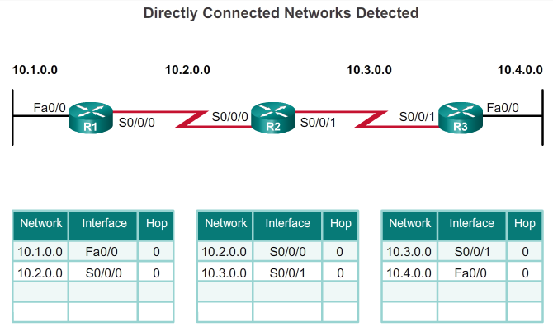
Routing Protocol Operating Fundamentals
Cold Start
R1 adds the directly connected networks 10.1.0.0 on interface Fa0/0 and 10.2.0.0 on S0/0/0 to its routing table.
R2 adds the directly connected networks 10.2.0.0 network on interface S0/0/0 and 10.3.0.0 on interface S0/0/1 to its routing table.
R3 adds the directly connected networks 10.3.0.0 on interface S0/0/1 and 10.4.0.0 on interface Fa0/0 to its routing table.
Routers configured with RIPv2
Notes:
7.1.3.2 Cold Start

Slide 10
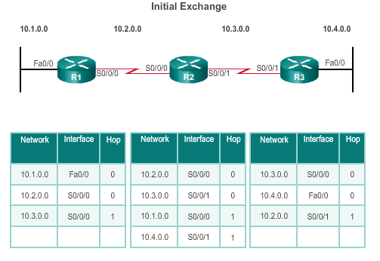
Routing Protocol Operating Fundamentals
Network Discovery
Router R1:
Sends an update about network 10.1.0.0 out the S0/0/0 interface
Sends an update about network 10.2.0.0 out the Fa0/0 interface
Receives update from router R2 about network 10.3.0.0 with metric of 1
Stores network 10.3.0.0 in the routing table with metric of 1 and reachable from exit interface S0/0/0
Routers configured with RIPv2
Notes:
7.1.3.3 Network Discovery

Slide 11
Routing Protocol Operating Fundamentals
Network Discovery (cont.)
Router R2:
Sends an update about network 10.3.0.0 out the S0/0/0 interface
Sends an update about network 10.2.0.0 out the S 0/0/1 interface
Receives an update from R1 about network 10.1.0.0 with metric of 1
Stores network 10.1.0.0 in the routing table with metric of 1
Receives an update from R3 about network 10.4.0.0 with metric of 1
Stores network 10.4.0.0 in the routing table with metric of 1
Routers configured with RIPv2
Notes:
7.1.3.3 Network Discovery (cont.)

Slide 12
Routing Protocol Operating Fundamentals
Network Discovery (cont.)
R3:
Sends an update about network 10.4.0.0 out the S0/0/1 interface
Sends an update about network 10.3.0.0 out the Fa0/0
Receives an update from R2 about network 10.2.0.0 with metric of 1
Stores network 10.2.0.0 in the routing table with metric of 1
Routers configured with RIPv2
Notes:
7.1.3.3 Network Discovery (cont.)

Slide 13
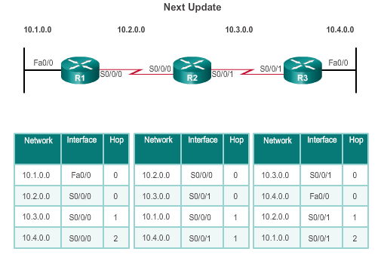
Routing Protocol Operating Fundamentals
Exchanging Routing Information
Router R1:
Sends an update about network 10.1.0.0 out the S0/0/0 interface
Sends an update about networks 10.2.0.0 and 10.3.0.0 out the Fa0/0 interface
Receives an update from R2 about network 10.3.0.0 with metric of 1 and 10.4.0.0 with metric of 2
Stores network 10.4.0.0 in the routing table with metric of 2
No change about network 10.3.0.0 with metric of 1. So routing information remains the same
Routers configured with RIPv2
Notes:
7.1.3.4 Exchanging the Routing Information

Slide 14
Routing Protocol Operating Fundamentals
Exchanging Routing Information (cont.)
Router R2:
Sends an update about networks 10.3.0.0 and 10.4.0.0 out S0/0/0 interface
Sends an update about networks 10.1.0.0 and 10.2.0.0 out S0/0/1 interface
Receives an update from R1 about network 10.1.0.0. No change; so the routing information remains the same.
Receives an update from R3 about network 10.4.0.0. No change; so the routing information remains the same.
Routers configured with RIPv2
Notes:
7.1.3.4 Exchanging the Routing Information (cont.)

Slide 15
Routing Protocol Operating Fundamentals
Exchanging Routing Information (cont.)
Router R3:
Sends an update about network 10.4.0.0 out S0/0/1 interface
Sends an update about networks 10.2.0.0 and 10.3.0.0 out Fa0/0 interface
Receives an update from R2 about network 10.1.0.0 with metric of 2
Stores network 10.1.0.0 in the routing table with metric of 2
Same update from R2 contains information about network 10.2.0.0 with metric of 1. No change; so the routing information remains the same.
Routers configured with RIPv2
Notes:
7.1.3.4 Exchanging the Routing Information (cont.)

Slide 16
Routing Protocol Operating Fundamentals
Achieving Convergence
The network is converged when all routers have complete and accurate information about the entire network:
Convergence time is the time it takes routers to share information, calculate best paths, and update their routing tables.
A network is not completely operable until the network has converged.
Convergence properties include the speed of propagation of routing information and the calculation of optimal paths.
Generally, older protocols, such as RIP, are slow to converge, whereas modern protocols, such as EIGRP and OSPF, converge more quickly.
Notes:
7.1.3.5 Achieving Convergence

Slide 17
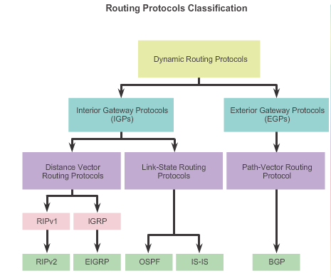
Types of Routing Protocols
Classifying Routing Protocols
Classful routing protocols
Subnet masks not sent in routing updates
Used when networks were assigned by Class A/B/C
Do not support VLSM and CIDR
Do not support discontiguous networks
Classless routing protocols
Subnet masks are sent in routing updates
Thus support VLSM/ CIDR/ discontiguous networks
Notes:
7.1.4.1 Classifying Routing Protocols

Slide 18
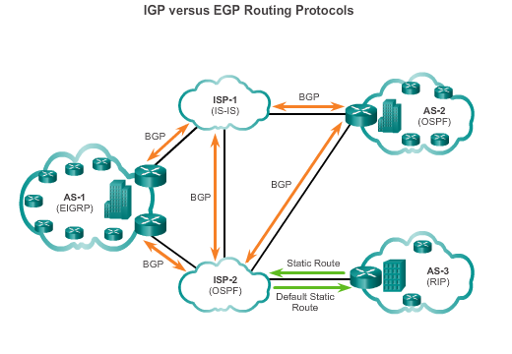
Types of Routing Protocols
IGP and EGP Routing Protocols
An Autonomous System (AS) is a collection of routers under a common administration such as a company or organization. Also known as a routing domain. An example is NYP’s internal network.
Interior Gateway Protocols (IGP) -
Used for routing within an AS
Include RIP, EIGRP, OSPF, IS-IS
Exterior Gateway Protocols (EGP) -
Used for routing between AS
Official routing protocol used by the Internet
Notes:
7.1.4.2 IGP and EGP Routing Protocols

Slide 19
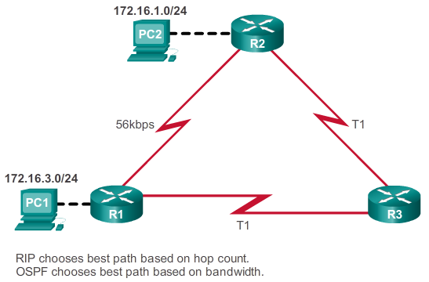
Types of Routing Protocols
Routing Protocol Metrics
A metric is a measurable value that is assigned by a routing protocol to different possible routes based on the usefulness of that route.
It is then used:-
To determine the overall “cost” of
a path from source to destination.
By the routing protocol to determine
the best path with the lowest cost.
Notes:
7.1.4.8 Routing Protocol Metrics

Slide 20
Types of Distance Vector Routing Protocols
Routing Information Protocol (RIP)
Characteristics of RIP:-
  Uses hop count as a metric with 15 as maximum value. A hop count of 16 indicates an unreachable route.
  Routing updates are sent every 30 seconds.
  Uses UDP as transport protocol on port 520.
  Administrative Distance (AD) is 120.
Some differences between RIPv1 and RIPv2:-
 | RIPv1 | RIPv2
Routing updates | Broadcast updates to 255.255.255.255 | Multicast updates to 224.0.0.9
Supports VLSM and CIDR | No | Yes
Supports summarization | No | Yes
Supports authentication | No | Yes
Notes:
7.2.2.1 Routing Information Protocol

Slide 21
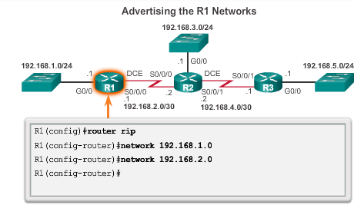
Configuring the RIP Protocol
Configuring RIPv1
Advertise using the keyword “network”.
Advertise only directly connected networks.
Advertise using the classful network address.
R2(config)#
R2(config-router)#
R2(config-router)#
R2(config-router)#
R3(config)#
R3(config-router)#
R3(config-router)#
Notes:
7.3.1.1 Router RIP Configuration Mode
7.3.1.2 Advertising Networks

Slide 22
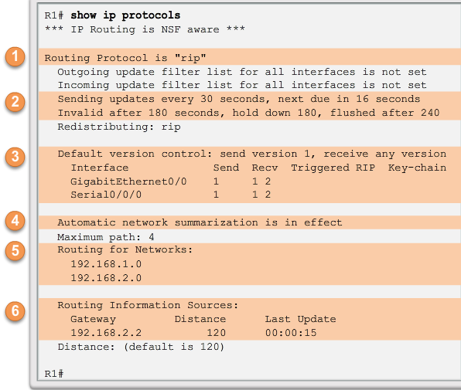
Configuring the RIP Protocol
Verifying RIP Settings
To check RIP configuration, use
#show ip protocols
RIP is enabled
The timers used by RIP
The RIP version configured
Status of automatic summarisation
The networks advertised
The RIP neighbours and next-hop IP address
Notes:
7.3.1.3 Examining Default RIP Settings

Slide 23
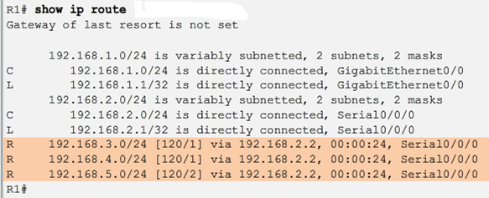
Configuring the RIP Protocol
Verifying Routing Table
To check the routing table, use #show ip route
When the network has converged, the router will show the remote network routes learnt from the neighbour routers (shown below with the route code “R”)
Notes:
7.3.1.3 Examining Default RIP Settings

Slide 24
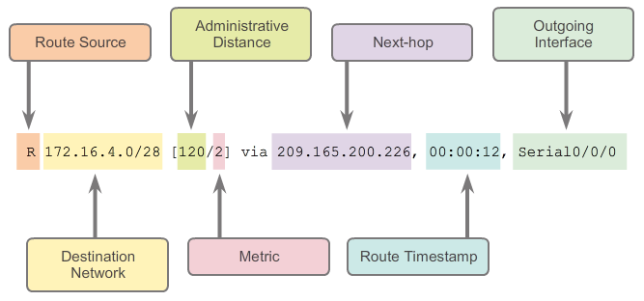
Parts of an IPv4 Route Entry
Remote Network Entries
Notes:
7.5.1.3 Remote Network Entries

Slide 25
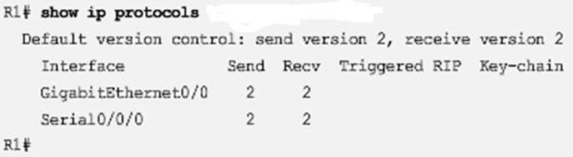
Configuring the RIP Protocol
Enabling RIPv2
By default, RIP starts in version 1. It sends routing updates in version 1 format but it is able to read both version 1 and 2 routing updates
To enable RIP in version 2:-
      Router(config)# router rip
      Router(config-router)# version 2
To check, again use # show ip protocols
Notes:
7.3.1.4 Enabling RIPv2

Slide 26
Configuring the RIP Protocol
Disabling Auto Summarization
By default, RIPv2 automatically summarizes networks at major network boundaries (a router that has interfaces with different class of addresses).
Causes routing problem for discontiguous networks and should be disabled:-
Router(config)# router rip
Router(config-router)# no auto-summary
Once disabled, #show ip protocols now states that automatic network summarization is not in effect.
RIPv2 now includes all subnets and their appropriate masks in its routing updates. #show ip route will display each individually learnt subnets without summarizing them.
Note: this command has no effect when using RIPv1.
Notes:
7.3.1.5 Disabling Auto Summarization

Slide 27
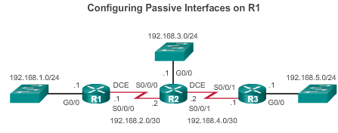
Configuring the RIP Protocol
Configuring Passive Interfaces
Should routing updates be sent to a PC?
ANS: ____________
Sending out unnecessary updates impacts the network in three ways:
Wasted Bandwidth
Wasted Resources
Security Risk
To disable routing updates being sent to the LAN, using router R1 as example:-
    R1(config)# router rip
    R1(config-router)# passive-interface g0/0
To check: #show ip protocols will list the configured passive interface
Notes:
7.3.1.6 Configuring Passive Interfaces

Slide 28
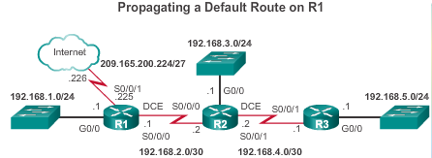
Configuring the RIP Protocol
Propagating a Default Route
Router R1 is on the edge
of the network and
connected to an ISP
for Internet access.
For R1 to route packets to the Internet,
a default static route needs to be configured:-
R1(config)# ip route 0.0.0.0 0.0.0.0 s0/0/1 209.165.200.226
Then use RIP to inform the other routers of this default route through R1:-
  R1(config)# router rip
  R1(config-router)# default-information originate
Check the routing table (#show ip route) at R2 and R3 to find a default route in the direction to R1.
Notes:
7.3.1.7 Propagating a Default Route

Slide 29
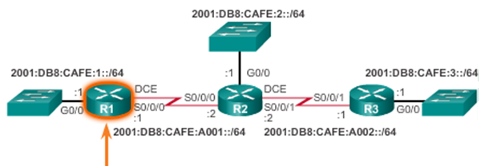
Configuring the RIPng Protocol
Advertising IPv6 Networks
IPv6 networks has a different approach for configuration:-
Step 1 – enable IPv6 routing
#ipv6 unicast-routing
Step 2 – enable ipv6 for RIP (note that [domain-name] is case-sensitive)
#ipv6 router rip [domain-name]
Step 3 – enable RIP on each active interface
#ipv6 rip [domain-name] enable
R1(config)# ipv6 unicast-routing
R1(config)# ipv6 router rip RIP-AS
R1(config-rtr)# exit
R1(config)# interface g0/0
R1(config-if)# ipv6 rip RIP-AS enable
R1(config)# interface s0/0/0
R1(config-if)# ipv6 rip RIP-AS enable
Notes:
7.3.2.1 Advertising IPv6 Networks

Slide 30
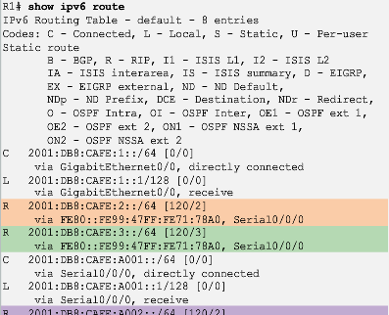
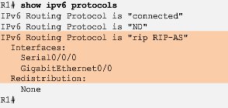
Configuring the RIPng Protocol
Examining the RIPng Configuration
To verify RIPng settings:-
# show ipv6 protocols
To check routing table:-
# show ipv6 route
Notes:
7.3.2.2 Examining the RIPng Configuration

Slide 31
Summary of RIP configuration commands
(A) RIP configuration
Router(config)# router rip
Router(config-router)# version 2
Router(config-router)# no auto-summary
Router(config-router)# network [classful-network-addr]
(B) Propagating a default static route using RIP
Router(config)# ip route 0.0.0.0 0.0.0.0 [exit-int] [next-hop-IP]
Router(config)# router rip
Router(config-router)# default-information originate
(C) RIPng configuration
Router(config)# ipv6 unicast-routing
Router(config)# ipv6 router rip [domain-name]
Router(config-rtr)# exit
Router(config)# interface [int-ID]
Router(config-if)# ipv6 rip [domain-name] enable

Slide 32
Chapter 7: Summary
Dynamic routing protocols:
Used by routers to automatically learn about remote networks from other routers
Purpose includes: to discover remote networks, maintain up-to-date routing information, choose the best path to destination networks, and to find a new best path if the current path is no longer available
Best choice for large networks but static routing is better for stub networks.
Function to inform other routers about changes
Can be classified as either classful vs classless, distance-vector vs link-state, and interior vs exterior gateway protocol
Metrics are used to determine the best path or shortest path to reach a destination network
Different routing protocols may use different (hops, bandwidth, delay, reliability, and load)
Notes:
Chapter 7 Summary

